Slide 1
Array Implementation
Submitted by: Asif Karim [1921559042]
Dewan Fahmida [1822214642]
Md Ahnaf Zaman [2011043042]
Section : 04

Slide 2
What is Array?
An Array is a group of consecutive memory locations with the same name and data type.
A simple variable is a single memory location with a unique name and a type. However, an Array is a collection of different adjacent memory locations. All these memory locations have one collective name and type.
The memory locations in the array are known as array elements. The total number of elements in the array is called length.
The elements of access regarding their position in the array are called index or subscript.

Slide 3
Essential Points About Arrays
An array can store many values with a single name. All arrays consist of consist of contiguous memory locations. The lowest address corresponds to the first element, and the highest to the last element.
Arrays are used to process many values easily and quickly. All arrays have 0 as the index, and an array's last index will be the array's total size minus 1.
The values stored in an array can be stored easily.
The search process can be applied to arrays easily.

Slide 4
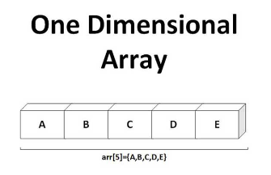
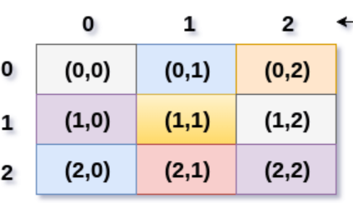
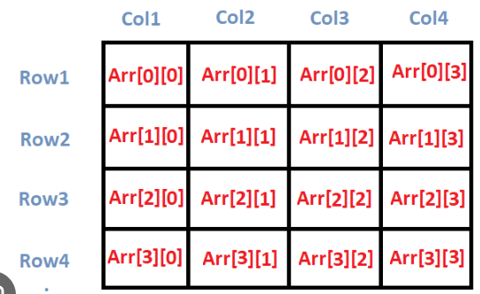
Types of Array
One dimensional array contains one row and multiple columns.
Simple collection of element.
2D Array
In this example, rows is set to 3, and columns is set to 3. Therefore, the 2D array has 3 rows and 3 columns.
Multidimensional Array
Multidimensional array contains multiple rows and multiple columns.
It is a collection of one dimensional array.

Slide 5
Array Initialization
As with simple variables arrays can be initialized while they are being declared.
When initializing arrays while declaring them not necessary to specify the size of an array.
The number of initial values in the braces determines the size of an array.
For example:
double sales[ ] = { 9.55, 55.30, 20.15, 30.25, 60.45, 10.25, 46.85};

Slide 6
Partial Initialization
The statement
int list [ ]= {5,6,8,9};
declares the list to be an array of 4 components and initializes list [0] to 5, list[1] to 6, list [2] to 8, and list [3] to 9.
The statement
int list [25]= {5,6,8,9};
declares the list to be an array of 25 components and the first four components are initialized to 5,6,8 and 9, respectively
All other components are initialized to 0

Slide 7
Declaration of Arrays
An ''Array declaration'' means to name the array and specify the type of its elements. It can also define the number of elements in the array. A variable with an array type is considered a pointer to the type of the array elements.
In Data Structures and Algorithm using C/C++, an array can be declared by specifying its type and size or by initializing.
Array declaration by specifying size:
int a[10];
Array declaration by initializing elements:
int a[] = {10, 20, 30, 40};
Here, in case the size of the array is omitted, an array just big enough to hold the Initialization is created. Consequently, the compiler creates an array of size 4. And above is the same as '' int a[4] = {10,20,30,40}; ''
Array declaration by specifying and initializing elements:
int a[6] = {10,20,30,40};
Here, in case the compiler creates an array of size 6, initializes the first 4 elements as specified by the user and the rest of the two elements as 0. above is the same as '' int a[4] = {10,20,30,40,0,0};

Slide 8
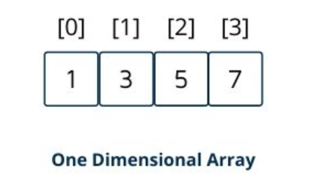

One-D Array
A type of Array in which all elements are arranged in the form of a list is known as 1-D Array, Single Dimension Array, or Linear List.
Declaring 1-D Array:
data_type identifier[length];
int marks [10];
Datatype: Data type of values to be stored in the Array.
Identifier: Name of the Array.
Length: Number of elements.
int catalogue 0 1 2 3
1-D array Initialization:
Syntex:
data_type identifer [length] = {List of values};
int marks[5] = {26,68,38,95,46};
Data type of values to be stored in the Array.
Identifier: Name of the Array.
Length: Name of elements.
List of Values: Values to initialize the Array. Initializing values must be constant.

Slide 9
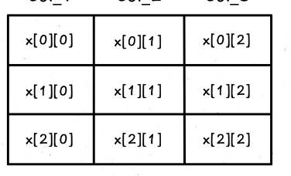
Accessing elements of an array
Individual Element:
Array_name[index];
Using Loop:
int marks[5];
for (int i=0; i<=4; i++)
marks[i] = i;
Two-D Arrays:
A two-D array can be considered a table consisting of rows and columns. Each element in a 2-D array is referred to with the help of two indexes. One index indicates a row, and the second indicates the column.
Declaring 2-D Array:
Data_type indefier[row][column];
Datatype: Data type of values to ber stored in the array.
Identifier: Name of the array.
Rows: # of Rows in the table of array.
Column: # of Columns in the table of array.

Slide 10
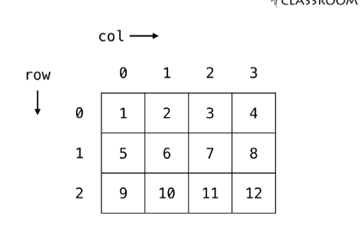
Two-D Array Initialization
The two-D Array can also be initialized at the time of declaration. Initialization is performed by assigning the initial values in braces separated by commas.
Some Important points about 2-D Array:
The elements of each row are enclosed within braces and seperated bty comma.
All rows are enclosed within braces.
For number arays, if all elements are not specified, the unsepecified elements are initialized by 0.
Syntax:
int arr[4][3]={{10,59,80},
{61,87,92},
{26,33,48},
{38,76,19}}

Slide 11
Multidimensional Arrays
Multidimensional Arrays: a collection of a fixed number of elements(also known as Components) arranged in n dimensions(n>=1).
Also known as an n-dimensional arrays.
The general syntax of declaring an n-dimensional array is:
datatype arrayName[intExp1] [intExp2]...[intExpn];
where intExp1, intExp2,... are constant expressions yielding positive integer values.

Slide 12
Basic operations of Array
Traverse - print all the array elements one by one.
Insertion - Adds an element at the given index.
Deletion- Deletes an element at the given index.
Search- Searches an element using the given index by the value.
Update- Updates an element at the given index.

Slide 13
Array in real life
Shopping List
Movie Theater Seats
Image Pixels
Music Playlist
Spreadsheet Cells
DNA Sequence
Grocery Store Inventory
Social Media Network

Slide 14
THANK YOU

